Slide 1
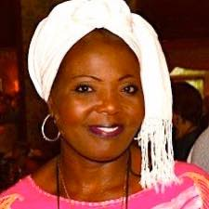
Khayanga Wisike Founder
Willing Hearts
Notes:
It is my pleasure to introduce Khayanga Wisike a Soroptimist and the Founder of Willing Hearts a registered charity in Canada with the focus of her work with girls in Kenya. We had hoped to conduct a study tour in November to this project but sadly it has been postponed to March 2021. She comes into contact with the issues of our appeal and educates girls from around the country.

Slide 2
Road To Equality
East Africa’s Challenges
and
Solutions
Khayanga Wasike

Slide 3
From the wall of a community outreach organisation in Kapenguria, West Pokot County,
Kenya

Slide 4
THE CHALLENGES
Violence Against Women
Early Marriage
Female Genital Mutilation
Human Trafficking / Slavery

Slide 5
Violence against Women
Cultural Beliefs that perpetuate violence :
Women must be submissive to male family members in all aspects of her life.
Men are expected to exercise coercive control.
Men have the right to discipline women for ‘incorrect’ behavior.
Women cannot deny their male partner sex.
Sexual harassment is normal.
Women experience violence because they are dressed ‘provocatively’.
All women should become mothers.
Girls are valued as wives not as individuals.
Heterosexuality is the only sexual orientation that is acceptable.
Divorced women have less value

Slide 6
Early Marriage
Who:
23% of Kenyan girls are married before their 18th birthday
4% are married before the age of 15.
Why: Your dowry is my inheritance ( or beer money )
Cultural traditions, religious and social pressures, fear of the child remaining unmarried into adulthood, illiteracy, and the perceived inability of women to work for money.

Slide 7
Female Genital Mutilation
What ?
Ranges from small nick in the clitoris to total removal of the vulva and sewing up the entrance to the vagina.
Why?
Belief that the girl would not be marriageable without it.
It was done to me so I will do it to my daughter !
Cultural traditions.
Marks the transition from girl to woman.

Slide 8
Human Trafficking / Slavery
Why
For the Victim - promise of a new life, money, education, prestige
For the Trafficker - money, prestige
When
Most victims go willingly, believing the promises of the trafficker.
What
60% domestic service, hospitality or service industry.
20% Sex workers - majority servicing local clientele and military.
Work long hours, no freedom, no money, no way to get home.
Physical & Sexual Abuse

Slide 9
Solutions

Slide 10
Violence against Women
Keep trying prevention programs, scale up the most promising ones, and study how well they work.
Make penalties for domestic violence consistent and very firm.
Increase funding for support services for victims of domestic violence.
Change the way family courts handle cases involving domestic violence.
Help women to be economically independent.
Make education and equal opportunities for women a priority in laws and principles

Slide 11
Early Marriage
Empower girls with information, skills and support networks.
Provide economic support and incentives to girls and their families.
Educate and rally parents and community members to understand challenges that girls face.
Mobilise families and communities to promote leadership and mentorship skills in girls.
Establish and implement laws and policies that protect girls and women.

Slide 12
Female Genital Mutilation
Challenge the discriminatory reasons FGM is practiced.
Change traditions with the support of and from older generations.
Educate girls on their right to decide what happens to their body.
Speak out about the risks and realities of FGM.
Spread understanding that religion does not demand FGM.
Raise awareness, do lots of community awareness in areas where the practice is rampant and stay vigilant

Slide 13
Human Trafficking / Slavery
Ways You Can Help End Trafficking:
Know the Signs. Learn the red flags and indicators of trafficking.
Report a Tip on the practice.
Spread the word on the reality of signs of human trafficking.
Think Before You Shop, about the workers who produce what you need.

Slide 14
Notes:
Thank you, Khayanga!
Over the last months we also noted that many clubs around the world were responding in their own unique ways to the pandemic. We knew this would become a topic for our UN meetings in the coming years and so we created a Google form to share your work. The themes for CSW and other international UN meetings will be related to the pandemic and we felt the collective impact of our global response would be helpful in capturing the information for our reports over the next year or two. The name Masks for Equality was launched to accompany Days for Girls and their Masks for Millions. Today, however, we are noting that much more is going on. The goal was to be able to measure something. For example how many of our Soroptimist countries responded, what is the range of projects/best practices. So whatever you are doing, whether it is supplying digital devices, checking in on isolated older women, supplying PPE, delivering food, helping with errands or even becoming literate with communications platform so your clubs can meeting safely…it is all important . In my work with older persons these women tell us that just knowing someone out there cares, is making their day. So we are not asking you to make masks, we are just requesting you to use the google form to tell us if you are doing something in response to COVID 19. Some of you report to your Federations already and so just one extra step. We have opportunities to feature some of this work in our global meetings.

Slide 15
NEXT WEBINAR: September
HUMAN TRAFFICKING
Notes:
Our next webinar will be held September 10 and will focus entirely on Trafficking. We will be sharing our new project that will expand on some of the work that has been underway with the Dutch union.
These webinars will also have other topics mixed in and will not all be Presidents Appeal topics but we are finding our way. Late September may be Older Women to coincide with International Day of Older Persons and in October we expect to have some excellent speakers on FGM. If you have speakers you have heard that are so fantastic you want others to hear we would love to hear from you.

Slide 17
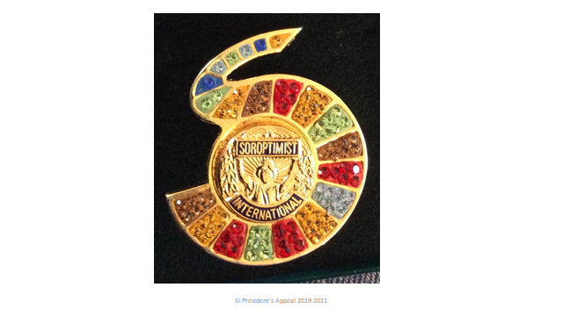
Pins are available for purchase from Hilary Laidler or Sharon Fisher.
Donation accepted by your Federation with direct link to remittance forms at: www.soroptimistinternational.org (Mark for Presidents Appeal)
Notes:
In closing, thank you for attending. Your support for Road to Equality is so very much appreciated. We have dedicated pages on the website for each topic of the appeal to share news, projects, Soroptimist Position Papers and more. We have social media and of course the new Soroptimist LAB that has Road to Equality for a topic and also an underlying team to stimulate the conversation.
Donations can be made through your Federations marked Presidents Appeal and 100% comes to SI. There are links on the website to each of the Federation’s remittance instructions. Also if you want to wear the Road to Equality pin they are available through Hilary Laidler in the UK and I also have a supply. Just contact anyone in the appeal or look online to get further details.

